Slide 1


Module 4 : Lecture 2
JAVA BASICS
by Andrei Kliashchonak
January 6, 2016

Slide 2
Module 3 : JAVA Basics : Agenda
1
2
3
Lecture 1
Lecture 2
Lecture 3
Overview
Type of data
Operators and operations
Classes / structures
Base API
OOP
Java Collection Framework
Input/Output streams
Exceptions
Enums

Slide 3
Object-Oriented Programming
with JAVA

Slide 4
OOP Principles
1
Abstraction
2
Encapsulation
3
Inheritance
4
Polymorphism

Slide 5
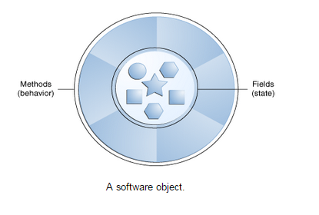
OOP Principles: Abstraction
Real-world objects share two characteristics: They all have state and behavior.
Identifying the state and behavior for real-world objects is a great way to begin thinking in terms of object-oriented programming.
Software objects are conceptually similar to real-world objects: they too consist of state and related behavior. An object stores its state in fields (variables in some programming languages) and exposes its behavior through methods (functions in some programming languages).

Slide 6
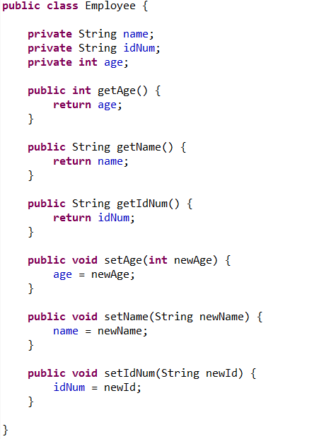
OOP Principles: Encapsulation
Encapsulation in Java is a mechanism of wrapping the data (variables) and code acting on the data (methods) together as single unit. In encapsulation the variables of a class will be hidden from other classes, and can be accessed only through the methods of their current class, therefore it is also known as data hiding.
To achieve Encapsulation in Java:
To declare the variables of a class as private
Provide public setter and getter methods to modify and view the variables values.

Slide 7
OOP Principles: Encapsulation
Benefits of Encapsulation:
1
The fields of a class can be made read-only or write-only.
2
A class can have total control over what is stored in its fields.
3
The users of a class do not know how the class stores its data. A class can change the data type of a field and users of the class do not need to change any of their code.

Slide 8
OOP Principles: Inheritance
Inheritance can be defined as the process where one class acquires the properties (methods and fields) of another. With the use of inheritance the information is made manageable in a hierarchical order.
The class which inherits the properties of other is known as subclass (derived class, child class) and the class whose properties are inherited is known as superclass (base class, parent class).
extends is the keyword used to inherit the properties of a class. Below given is the syntax of extends keyword.

Slide 9
OOP Principles: Inheritance
In the absence of any other explicit superclass, every class is implicitly a subclass of Object.
Access to base class (its methods) is done using the super keyword. Constructor may send parameters to its base using the‘super’ keyword as its first instruction
Methods of subclass can complement the base class methods and replace them (override).
Excepting java.lang.Object, which has no superclass, every class has exactly one and only one direct superclass (single inheritance).

Slide 10
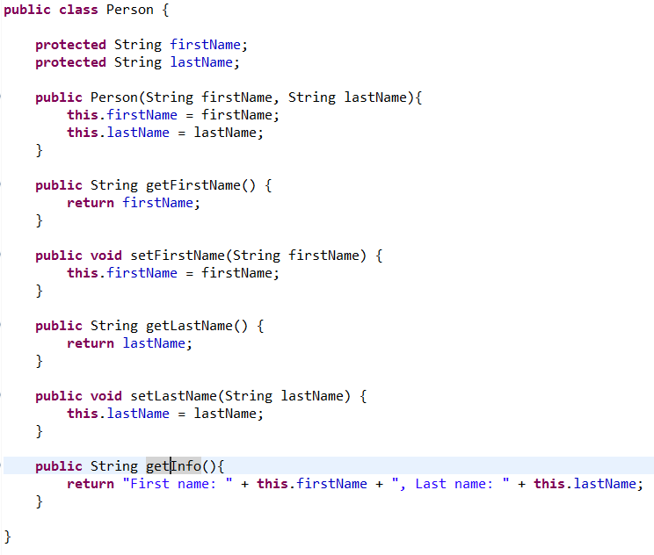
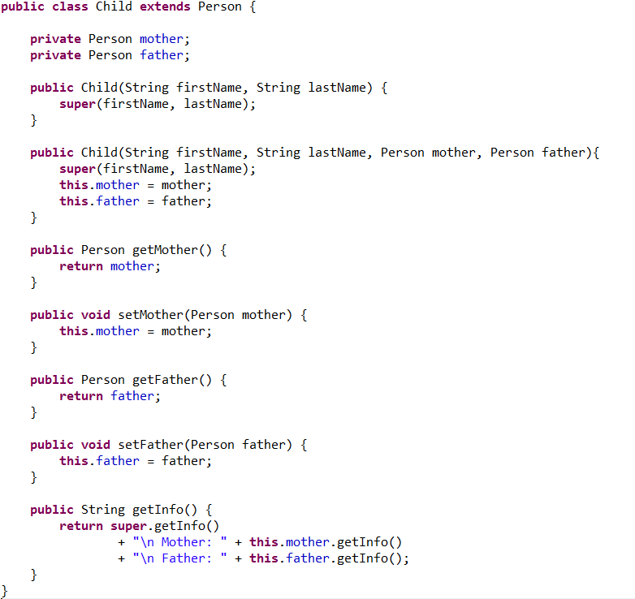
OOP Principles: Inheritance

Slide 11
OOP Principles: Polymorphism
Polymorphism via Interfaces
Polymorphism via Inheritance
Polymorphism via Abstract Classes
Polymorphism of methods

Slide 12
OOP Principles: Interfaces
An interface is a reference type in Java, it is similar to class, it is a collection of abstract methods. A class implements an interface, thereby inheriting the abstract methods of the interface.
Interface is a contract
An interface can contain method signatures (methods without implementation) and static constants
Interface cannot be instantiated, it can only be implemented by classes and extended by other interfaces
Class can implement several interfaces (contracts)

Slide 13
OOP Principles: Interfaces
An interface is similar to a class in the following ways:
An interface can contain any number of methods.
An interface is written in a file with a .java extension, with the name of the interface matching the name of the file.
The byte code of an interface appears in a .class file.
Interfaces appear in packages, and their corresponding bytecode file must be in a directory structure that matches the package name.

Slide 14
OOP Principles: Interfaces
However, an interface is different from a class in several ways, including:
You cannot instantiate an interface.
An interface does not contain any constructors.
All of the methods in an interface are abstract (have no implementation).
An interface cannot contain instance fields. The only fields that can appear in an interface must be declared both static and final.
An interface is not extended by a class; it is implemented by a class.
An interface can extend multiple interfaces.

Slide 15
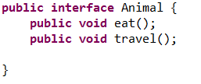
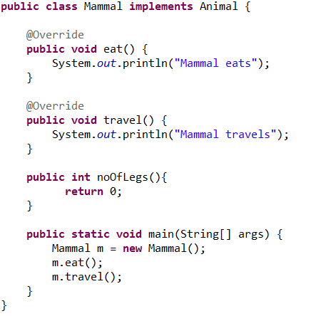
OOP Principles: Interfaces

Slide 16
OOP Principles: Abstract Classes
A class which contains the abstract keyword in its declaration is known as abstract class.
Abstract classes may or may not contain abstract methods ie., methods with out body ( public void get(); )
But, if a class have at least one abstract method, then the class must be declared abstract.
If a class is declared abstract it cannot be instantiated.
To use an abstract class you have to inherit it from another class, provide implementations to the abstract methods in it.
If you inherit an abstract class you have to provide implementations to all the abstract methods in it.

Slide 17
OOP Principles: Abstract Classes
Declaring a method as abstract has two consequences:
The class containing it must be declared as abstract.
Any class inheriting the current class must either override the abstract method or declare itself as abstract.
Abstract Class vs Interface - Remember two rules:
If the class is having few abstract methods and few concrete methods: declare it as abstract class.
If the class is having only abstract methods: declare it as interface

Slide 18
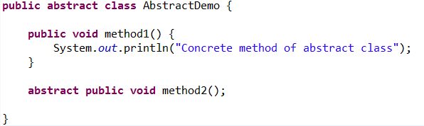

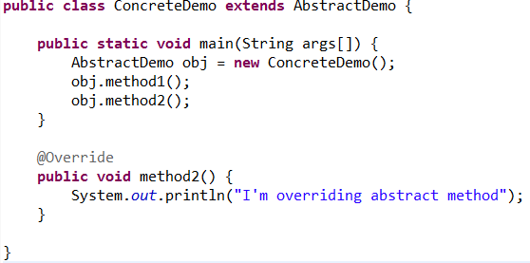
OOP Principles: Abstract Classes
Result:

Slide 19
JAVA Collection Frameworks

Slide 20
Collections Framework : Overview
A collections framework is a unified architecture for representing and manipulating collections.
The collections framework was designed to meet several goals.
The framework had to be high-performance. The implementations for the fundamental collections (dynamic arrays, linked lists, trees, and hashtables) are highly efficient.
1
2
The framework had to allow different types of collections to work in a similar manner and with a high degree of interoperability.
3
Extending and/or adapting a collection had to be easy.

Slide 21
Collections Framework : Overview
Collection Framework
Interfaces: These are abstract data types that represent collections. Interfaces allow collections to be manipulated independently of the details of their representation. In object-oriented languages, interfaces generally form a hierarchy.
Implementations, i.e., Classes: These are the concrete implementations of the collection interfaces. In essence, they are reusable data structures.
Algorithms: These are the methods that perform useful computations, such as searching and sorting, on objects that implement collection interfaces. The algorithms are said to be polymorphic: that is, the same method can be used on many different implementations of the appropriate collection interface.

Slide 22
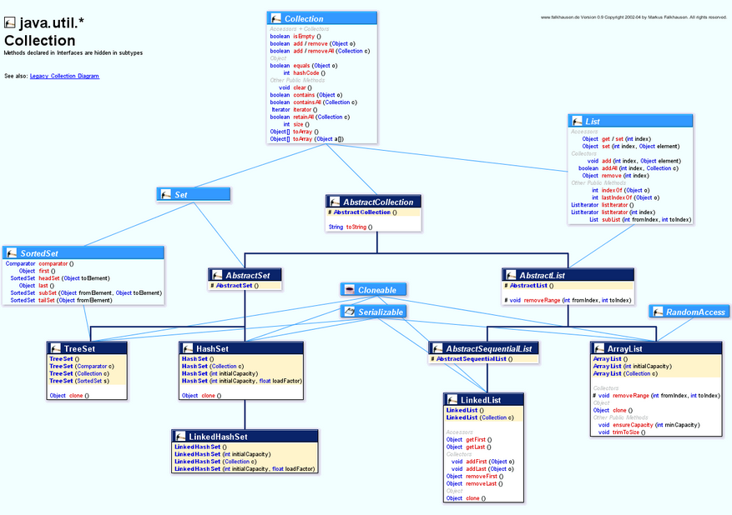
Collections Hierarchy in Java

Slide 23
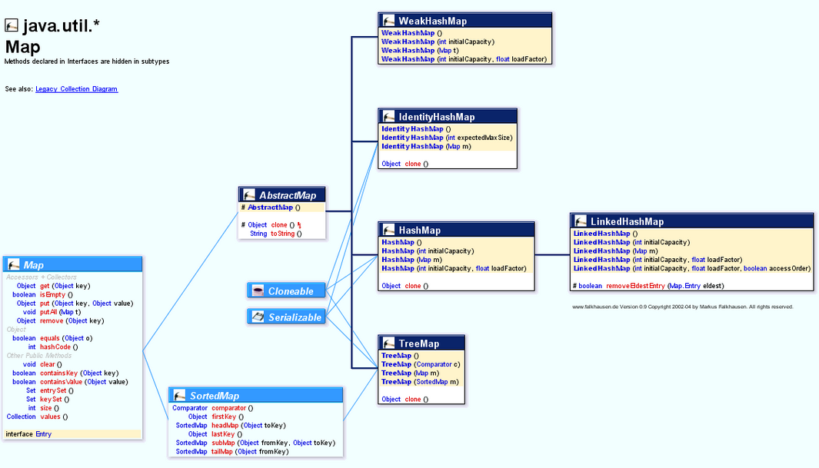
Maps Hierarchy in Java

Slide 24
Collections: List
A List is an ordered collection (sometimes called a sequence). Lists may contain duplicate elements. In addition to the operations inherited from Collection, the List interface includes operations for the following:
Positional access — manipulates elements based on their numerical position in the list. This includes methods such as get, set, add, addAll, and remove.
Search — searches for a specified object in the list and returns its numerical position. Search methods include indexOf and lastIndexOf.
Iteration — extends Iterator semantics to take advantage of the list's sequential nature. The list Iterator methods provide this behavior.
Range-view — The sublist method performs arbitrary range operations on the list.

Slide 25
Collections : List : ArrayList
void add(int index, E element)
void addAll(int index, Collection<? extends E> c)
E get(int index)
int indexOf(Object ob)
E remove(int index) –
E set(int index, E element)
List<E> subList(int fromIndex, int toIndex)
Inserts the specified element at the specified position in this list.
Inserts all of the elements in the specified collection into this list, starting at the specified position.
Returns the element at the specified position in this list.
Returns the index of the first occurrence of the specified element in this list, or -1 if this list does not contain the element.
Removes the element at the specified position in this list.
Replaces the element at the specified position in this list with the specified element.
Returns a view of the portion of this list between the specified , inclusive, and , exclusive.

Slide 26
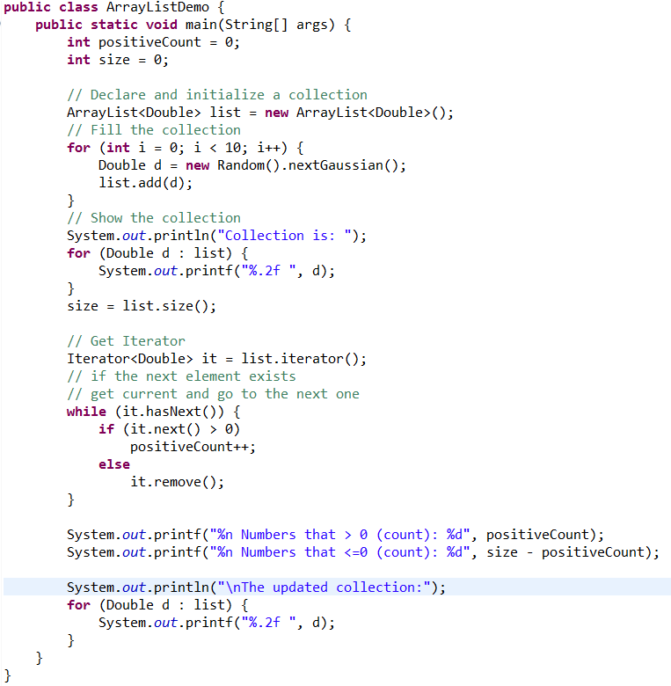
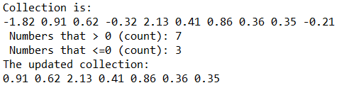
Collections : List : ArrayList
Result:

Slide 27
Collections : List : LinkedList
addLast(E ob), void addFirst(E ob), void E getFirst(), E getLast(), E removeFirst(), E removeLast()
boolean offer(E o)
E peek()
E poll(), E remove()
appends, returns, removes the first and the last elements from the collection (accordingly)
Adds the specified element as the tail (last element) of this list.
Retrieves, but does not remove, the head (first element) of this list.
Retrieves and removes the head (first element) of this list.

Slide 28
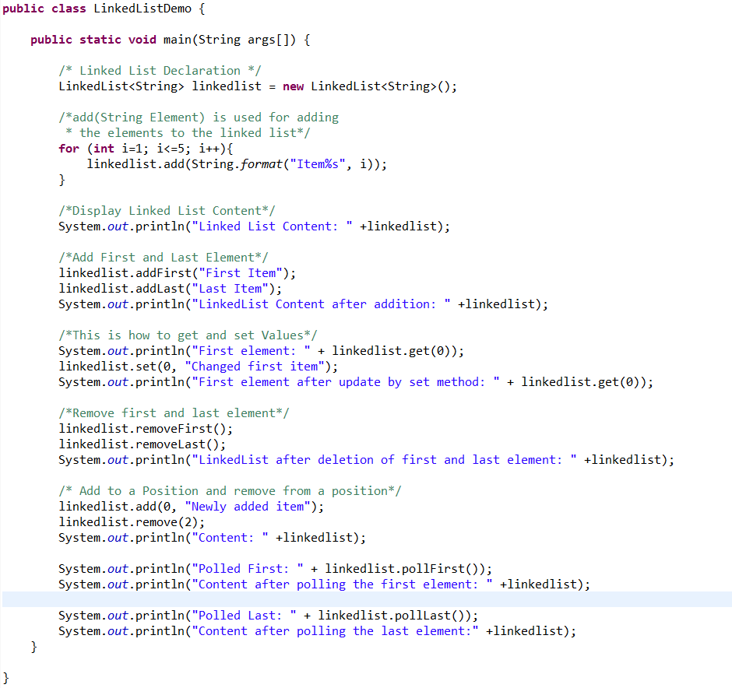
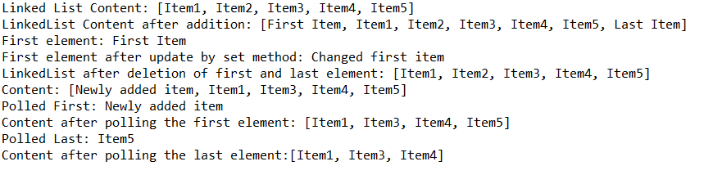
Collections : List : LinkedList
Result:

Slide 29
Collections: Sets
A Set is a collection that cannot contain duplicate elements. It models the mathematical set abstraction. The Set interface contains only methods inherited from Collection and adds the restriction that duplicate elements are prohibited.
Set also adds a stronger contract on the behavior of the equals and hashCode operations, allowing Set instances to be compared meaningfully even if their implementation types differ. Two Set instances are equal if they contain the same elements.
HashSet
…stores its elements in a hash table, is the best-performing implementation; however it makes no guarantees concerning the order of iteration.
TreeSet
…stores its elements in a red-black tree, orders its elements based on their values; it is substantially slower than HashSet.
… is implemented as a hash table with a linked list running through it, orders its elements based on the order in which they were inserted into the set (insertion-order)
LinkedHashSet

Slide 30
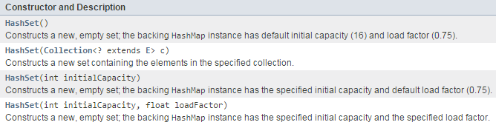
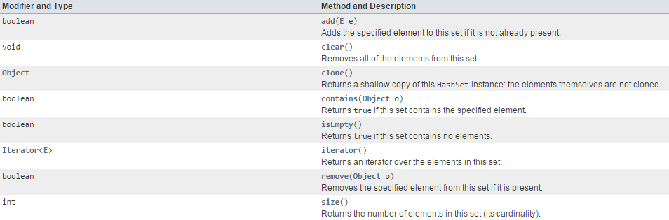
Collections: Set : HashSet
HashSet: Constructors
HashSet: Methods

Slide 31
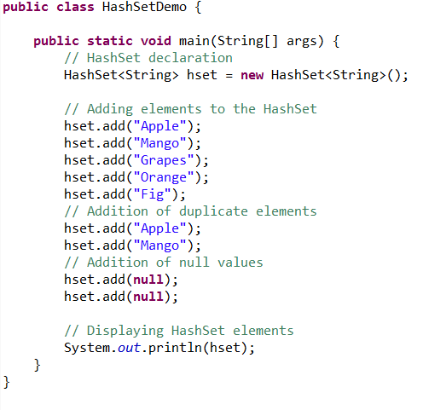

Collections: Set : HashSet
Result:

Slide 32
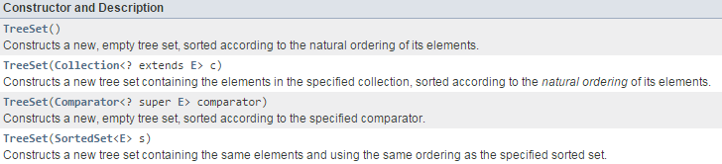
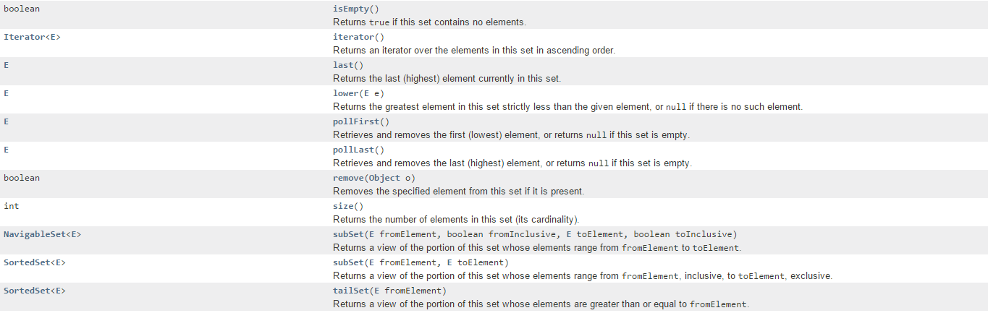
Collections: Sets: TreeSet
TreeSet: Constructors
TreeSet: Methods

Slide 33
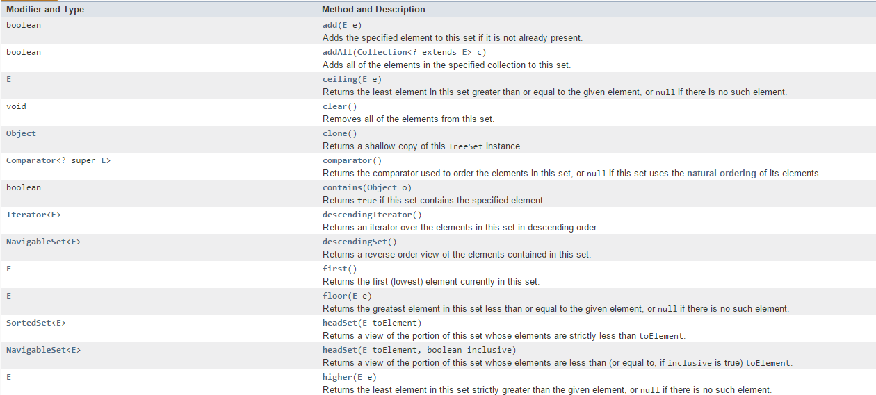
TreeSet: Methods

Slide 34
Maps
A Map is an object that maps keys to values. A map cannot contain duplicate keys: Each key can map to at most one value. It models the mathematical function abstraction. The Map interface includes methods for basic operations (such as put, get, remove, containsKey,containsValue, size, and empty), bulk operations (such as putAll and clear), and collection views (such as keySet, entrySet, and values).
The Java platform contains three general-purpose Map implementations: HashMap, TreeMap, and LinkedHashMap. Their behavior and performance are precisely analogous to HashSet, TreeSet, and LinkedHashSet.

Slide 35
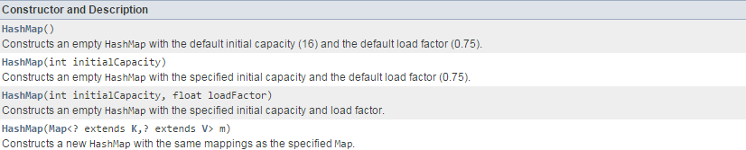
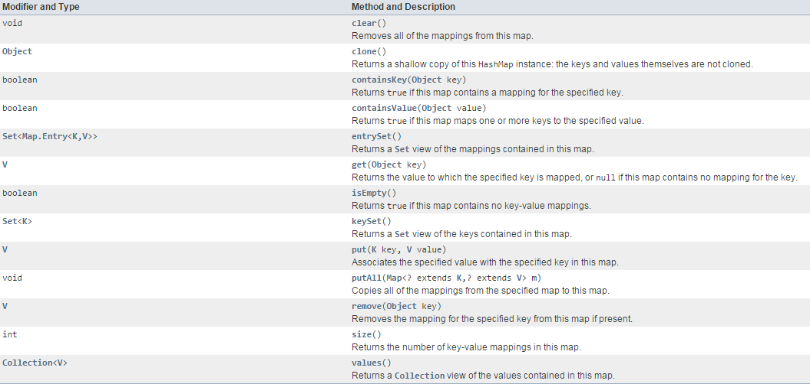
Maps: HashMap
HashMap: Constructors
HashMap: Methods

Slide 36
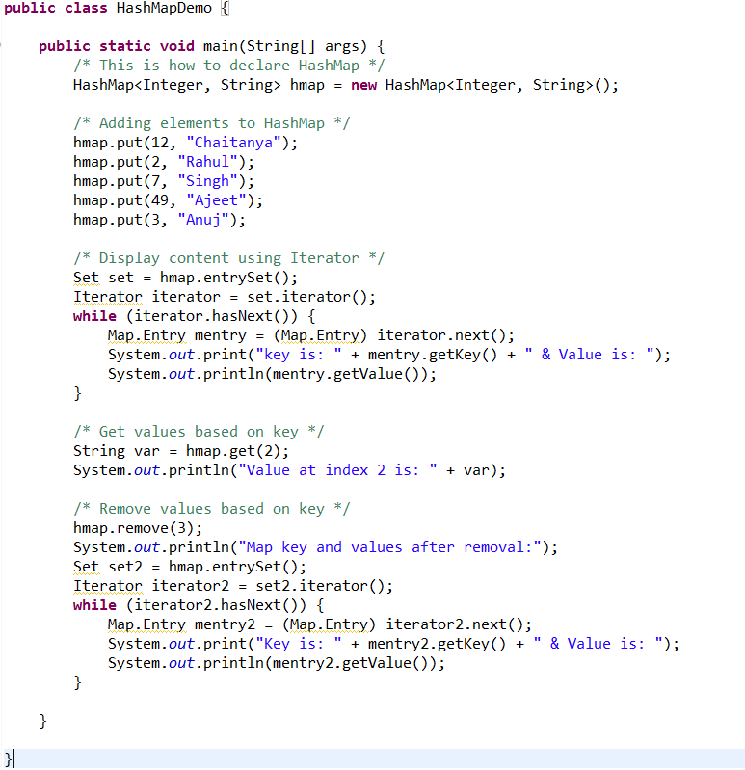
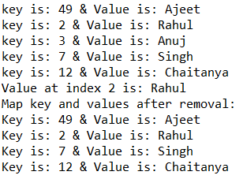
Maps: HashMap
Result:

Slide 37
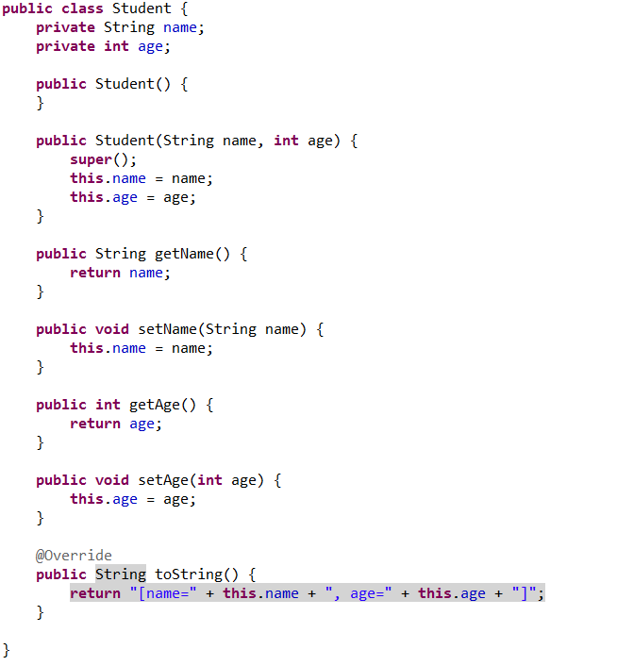
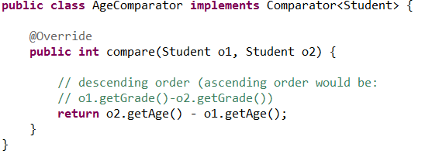
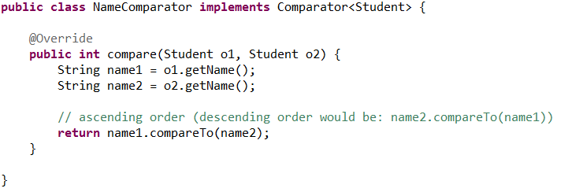
Sorting of Collections (Interface Comparator<T> )

Slide 38
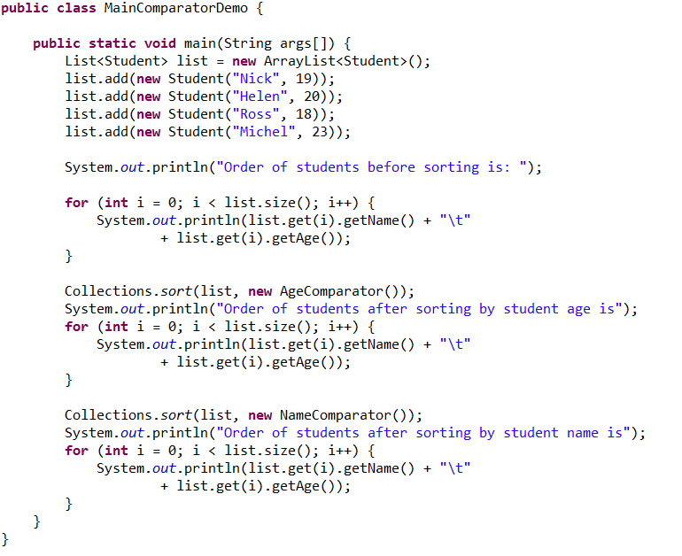
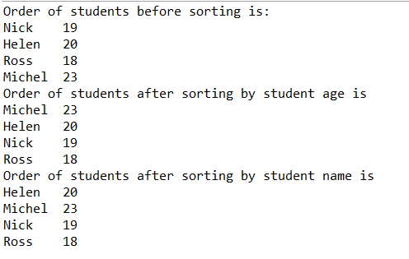
Sorting of Collections (Interface Comparator<T> )
Result:

Slide 39
Home Tasks
Implement an object model for a given domain
Compare the speed of collection classes work (add, delete, search for items)

Slide 40
Questions ?

Slide 41
Thanks for Your Attention!
EPAM Systems – CN TA 2015-2016 Java Basics Lecture 2
By:
Andrei Kliashchonak Lead Software Test Automation Engineer
EPAM Systems, BY, Test Automation Department #1, Orange Team
E-mail: Andrei_Kliashchonak@epam.com Skype: andrei.kliashchonak

